Slide 1
Stack

Slide 2
Stack (Last In First Out Discipline) LIFO
  Public interface Stack {
  int pop();
  void push(int value);
  boolean isEmpty();
  int peek();
  }
  Peek looks at what is at the top of the stack without removing it.
  Pop removes an item from the top of the stack.
  Push adds an item to the top of the stack.
  isEmpty tells us whether or not it is empty.

Slide 3
Palindrome
Palindromic
2002
2112
amanaplanacanalpanama
Use a stack of characters to figure out whether an input is a palindrome?

Slide 4




Slide 7
public interface MyStack {
boolean isEmpty();
void push(int value);
int pop();
int peek();
}
Stack: Array Implementation
public class StackExperiment {
/**
* @param args the command line arguments
*/
public static void main(String[] args) {
MyStack s = new MyStackImpl();
s.push(5);
s.push(6);
int a = s.pop();
System.out.println(""+ a);
}
}

Slide 8
public class MyStackImpl implements MyStack {
private int[] data;
int top;
public MyStackImpl() {
data = new int[10];
top = -1; // Empty stack
}
@Override
public int peek() {
return this.data[top];
}
@Override
public void push(int value) {
top = top + 1;
data[top] = value;
}
public int pop() {
return this.data[top--];
}
public boolean isEmpty() {
return top == -1 ? true : false;
}
}

Slide 9






Slide 10
Stack Linked List Implementation
public interface MyStack {
boolean isEmpty();
void push(int value);
int pop();
int peek();
}
public class StackExperimentTwo {
/**
* @param args the command line arguments
*/
public static void main(String[] args) {
MyStack s = new MyStackImpl();
s.push(5);
s.push(6);
int a = s.pop();
System.out.println(""+ a);
}
}

Slide 11
public class MyStackNode {
private int value;
private MyStackNode next;
public MyStackNode(int value) {
this.value = value;
next = null;
}
public int getValue() {
return value;
}
public void setValue(int value) {
this.value = value;
}
public MyStackNode getNext() {
return next;
}
public void setNext(MyStackNode next) {
this.next = next;
}
@Override
public String toString() {
return "MyStackNode{" + "value=" + value + ", next=" + next + '}';
}
}

Slide 12
public class MyStackImpl implements MyStack {
private MyStackNode stack;
public MyStackImpl() {
stack = null;
}
public boolean isEmpty() {
return stack == null? true: false;
}
public void push(int value) {
MyStackNode temp = new MyStackNode(value);
temp.setNext(stack);
stack = temp;
}
public int pop() {
int returnValue = stack.getValue();
stack = stack.getNext();
return returnValue;
}
public int peek() {
return stack.getValue();
}
}

Slide 13
Queue

Slide 14
Queue (First In First Out - Discipline) FIFO
Array Version
Interface
  enqueue – add to the end or rear of the queue
  Dequeue – remove from the front of the queue
  isEmpty – check if empty
  Poll – check what value is at the front of the queue
  insertBefore
  insertAfter
  deleteBefore
  deleteAfter

Slide 15


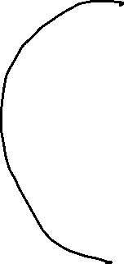
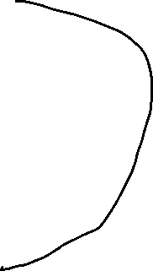


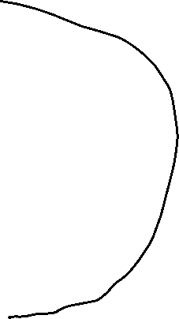
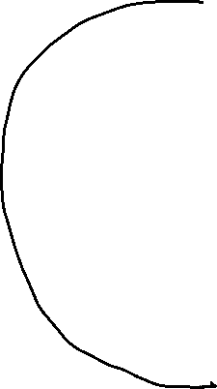





Slide 18
Circular Queue
while (!q.isEmpty()) {
System.out.println("" + q.dequeue());
}
for (int i = 9; i <= 15; i++) {
if (!q.isFull()) {
q.enqueue(i);
}
}
while (!q.isEmpty()) {
System.out.println("" + q.dequeue());
}
}
}
public interface MyQueue {
void enqueue(int value);
int dequeue();
boolean isEmpty();
boolean isFull();
int poll();
}
public class CircularQueue {
/**
* @param args the command line arguments
*/
public static void main(String[] args) {
MyQueue q = new MyCircularQueueImpl();
for (int i = 0; i <= 8; i++) {
if (!q.isFull()) {
q.enqueue(i);
}
}

Slide 19
public class MyCircularQueueImpl implements MyQueue {
private int[] data;
private int front;
private int rear;
private int count;
public MyCircularQueueImpl() {
data = new int[10];
front = 0;
rear = 0;
count = 0;
}
public void enqueue(int value) {
data[rear] = value;
rear = (rear + 1) % data.length; // Clock arithmetic
count++;
}
public int dequeue() {
int returnValue = data[front];
front = (front + 1) % data.length;
count--;
return returnValue;
}
public boolean isEmpty() {
return count == 0? true : false;
}
public boolean isFull() {
return count == data.length? true: false;
}
public int poll() {
return data[front];
}
}

